Slide 1
Detecting JavaScript
Races that Matter
Erdal Mutlu¹, Serdar Taşıran ¹, Benjamin Livshits ²
¹ Koç University, Istanbul
² Microsoft Research, Redmond
Notes:
I will be talking about our work on detecting races in JavaScript applications. As the title suggest we are looking for races that really matter in the end and hopefully I will be able to convince you into our view of races on JS.

Slide 2
JavaScript Races: Is It Even Possible?
Notes:
First of all, as you might know JS has a single threaded execution model, meaning that there is no real concurrency so how is races possible in JS setting.

Slide 3
Asynchrony in JavaScript: A Short Primer
Asynchronous XmlHttpRequest (XHR) Network Calls
Asynchronous XmlHttpRequest (XHR) Network Calls
setInterval(doSomething, 1000);
setTimeout(doSomething, 1000);
onClick(doSomething);
Asynchronous user events
to react to button clicks
Asynchronous Timed Events
var xhr = new XMLHttpRequest();
xhr.open(“GET”, “http://server_name/data.json”);
xhr.send();
xhr.onreadystatechange = parseResult(result);
      $.getJSON(“http://server_name/data.json”,parseResult(result));
Notes:
Here are some constructs that allows you to have asynchrony in JS.
Xhr’s mostly used for dynamically requesting data from the server and updating the state accordingly
Timed events used for periodic function executions like a polling on the user events on the page
User events like button clicks are the main way of interaction on the web apps

Slide 4


JavaScript Race Example: Memory
<html>
<script>
var localVar = “http://server_name/data.json”
var url1 = localVar;
$.getJSON( url1, function(result){
localVar = getUrl(result);});
</script>
…
<script>
var url2 = localVar;
$.getJSON( url2, function(result){
localVar = getUrl(result);});
</script>
…
<body>
alert(localVar);
</body>
</html>
Refresh
Alert?
Notes:
Okay, now let’s go over a racy scenario
Here the possible racy condition is the possibility of having different schedules like this.
Forgiving nature of JS execution model
But these effects are on transient state like on a shared variable which is ephemeral such that it can go away with just a refresh

Slide 5
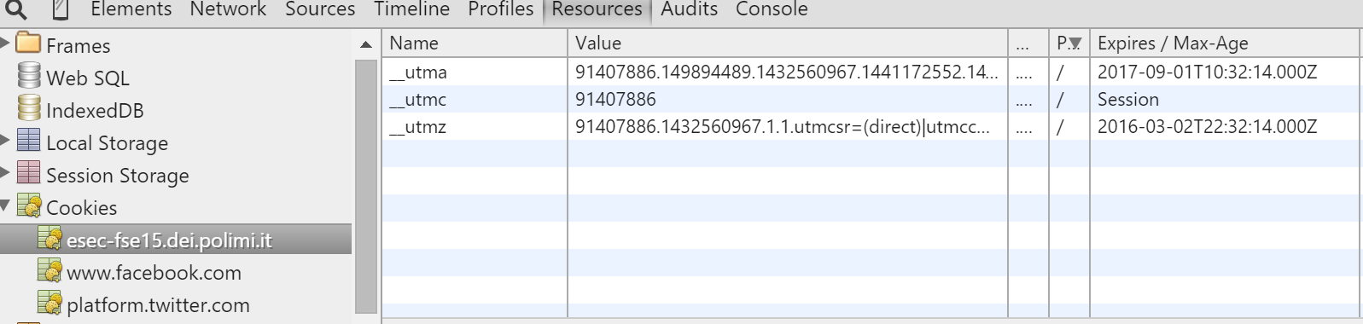
Cookies: Example of Persistent Data Storage
Notes:
Now let’s look at some persistent data storage like cookies.
Here is a screen capture from the conference web page. As you can see there are 3 different web sites most probably used for tracking some kind of events during the browsing of the page. And see the expiration date here. This states that these will stay in your persistent storage for a long time unless you clear your cookies.

Slide 6
JavaScript Race Example: Cookie
<html>
<script>
$.getJSON($.cookie(‘url’), function(result){
$.cookie(‘url’, getUrl(result));
});
</script>
…
<script>
$.getJSON($.cookie(‘url’), function(result){
$.cookie(‘url’, getUrl(result));
});
</script>
…
<body>
alert($.cookie(‘url’));
</body>
</html>
Alert?
Notes:
Now let’s think of a similar scenario but now these XHR callbacks are updating the cookie state.

Slide 7
JavaScript Race Example: Cookie
<html>
<script>
$.getJSON($.cookie(‘url’), function(result){
$.cookie(‘url’, getUrl(result));
});
</script>
…
<script>
$.getJSON($.cookie(‘url’), function(result){
$.cookie(‘url’, getUrl(result));
});
</script>
…
<body>
alert($.cookie(‘url’));
</body>
</html>
Refresh
Notes:
But different than the previous case a refresh won’t help you. Even closing and opening your browser won’t help you.
I am sure that you must have encountered a case where a corrupted cookie effected your browsing experience and you have to clear your cookie to get the good old web page you have been browsing daily.

Slide 8
Not All JavaScript Races Are Made Equal
Existing work on race detection in JavaScript [EventRacer^{[1]}, Wave^{[2]}]
Persistent but very rare
Somewhat common but benign
[1] Raychev et. al. “Effective race detection for event-driven programs”, OOPSLA’13
[2] Hong et. al. “Detecting concurrency errors in client-side JavaScript web applications”, ICST’14
Notes:
This paper argues that one has to take into account the location the race happens persistent state / transient
And our evaluation shows that persistent races are very rare as opposed to races on transient state that are more common

Slide 9



Research Questions?
RQ1: How common are races on persistent state such as document.cookie, localStorage, and side-effects such as POST requests?
RQ2: How common are races on session state, such as sessionStorage which is cleared on browser restarts?
RQ3: How common are races on transient state such as memory locations and DOM elements?
Notes:
In this paper, we tried to answer the following questions
1- …. which we think as the pure evil races
2- …. which can be counted as an unhappy evil as these state is cleared once you closed your browser hopefully you mostly do
3- …. which we identify like this octopus which is also purple but not that scarry

Slide 10
Analysis Technique
Notes:
Okay now let’s talk about technical stuff like our analysis

Slide 11
Analysis Tradeoffs
Collect traces dynamically by instrumenting Firefox browser
Analyze traces statically for possible data races
You are here
Static analysis
Dynamic analysis
Notes:
In the one end there is static analysis which fells short even to enumerate all the relevant code with the dynamic nature of JS.
On the other hand there are dynamic analysis hits to the scalability wall with schedule exploration or became vulnerable by loosing precision
So to avoid these pitfalls we devised a hybrid analysis where…

Slide 12
Firefox Instrumentation
Instrumented Firefox for recording
  Memory read-writes
  Persistent state read-writes (document.cookie, localStorage etc.)
  Session state read-writes (sessionStorage, DOM state etc.)
  Asynchronous callback block begin-end
Around 430 lines of instrumentation code spanning
  Cross platform component objects (XPCOM)
  Gecko (Layout Engine)
  SpiderMonkey (JS Engine)
Notes:
Record relevant information for the static analysis
Hb relation – memory updates
Our instrumentation code is quite modest with only 430 line of code added to different modules of Firefox

Slide 13
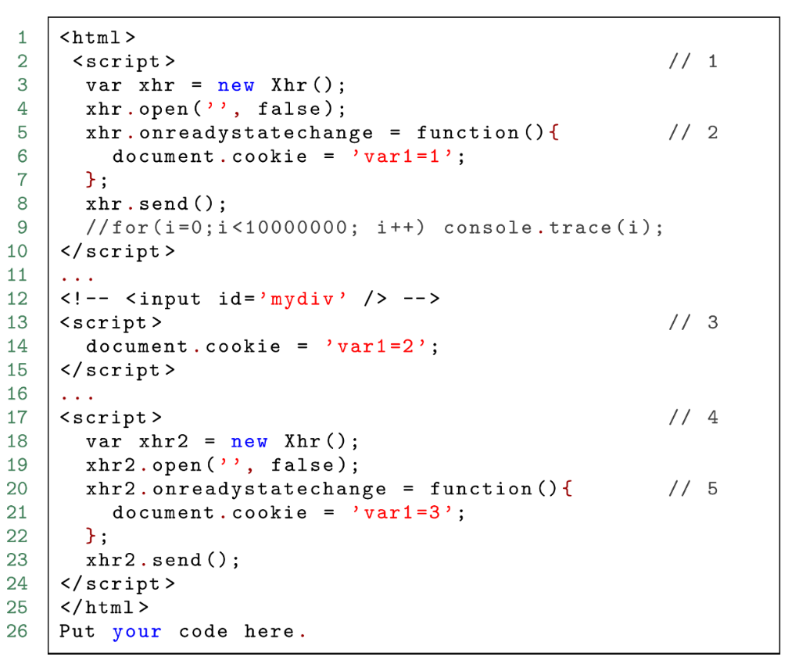
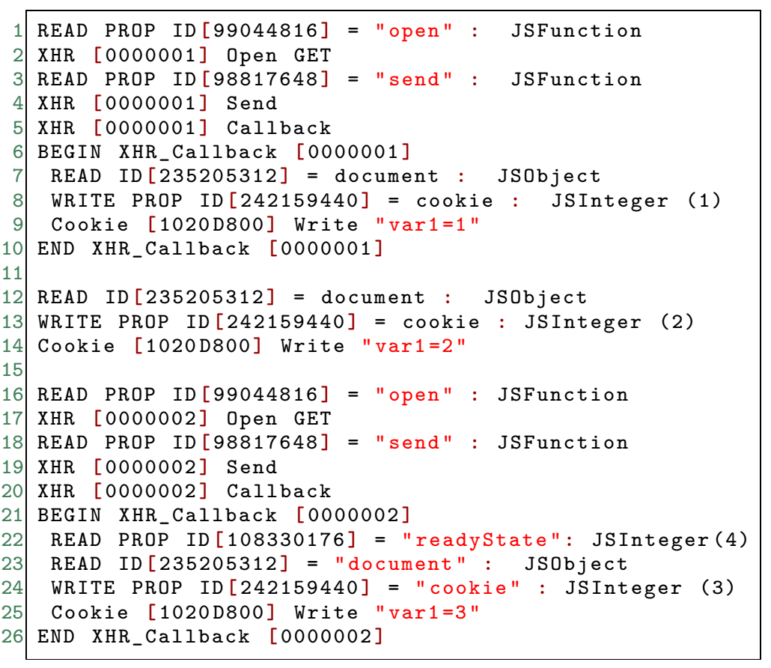
Firefox Instrumentation
Static source code
Runtime execution trace
Notes:
Okay let’s go over a trace example. Here on the left we have the static source code and on the right we have the trace collected on runtime
Point out the case that the onreadystatechange is executed after send! And possible updates on the cookie variable

Slide 14
Happens-Before Relation in JavaScript
Notes:
And now lets talk about happens before information, JS is executed by indivisible blocks source code

Slide 15
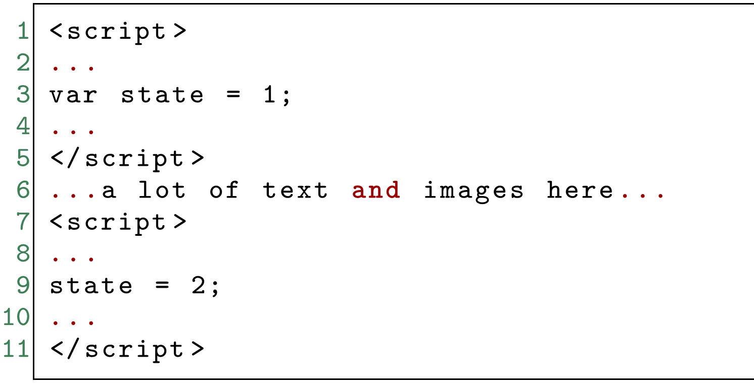
Happens-Before: Sequential Blocks
ScriptBlock1
ScriptBlock2
ScriptBlock1 ← ScriptBlock2
Notes:
Here check out this source code where there are two consecutive script blocks
As these blocks are executed indivisibly in program order these two blocks had a happens-before relation

Slide 16
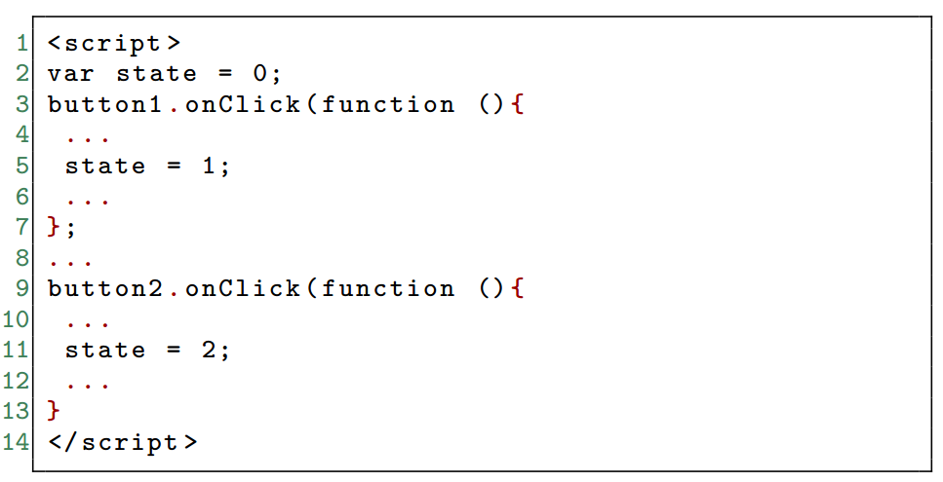
Happens-Before: User Interactions
ButtonClick1
ButtonClick2
ButtonClick1 ← ButtonClick2
Notes:
Another case for having a happens before relation
Assume that there are 2 button click callbacks like here and the user clicked button 1 and than button 2
So there will be a hb between these two

Slide 17
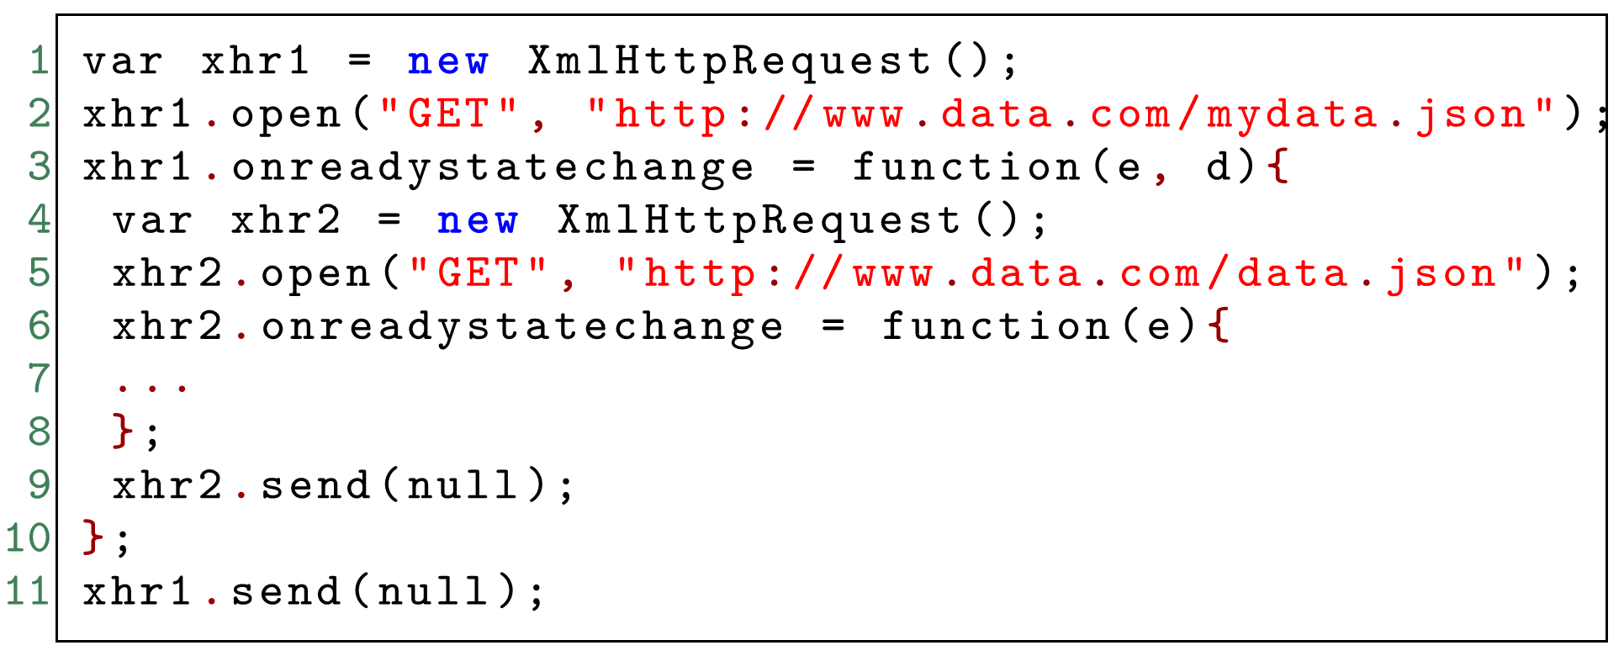
Happens-Before: Chained XHR Blocks
xhr1.onreadystatechange ← xhr2.onreadystatechange
Notes:
And the last but the not least case for a hb relation
Here we have an interesting structure a chained xhr meaning that they are guaranteed to be order in this particular order!
So there hb between these two
So any other case than these 3 cases there is no ordering constraint between async events which means they are possible concurrent

Slide 18
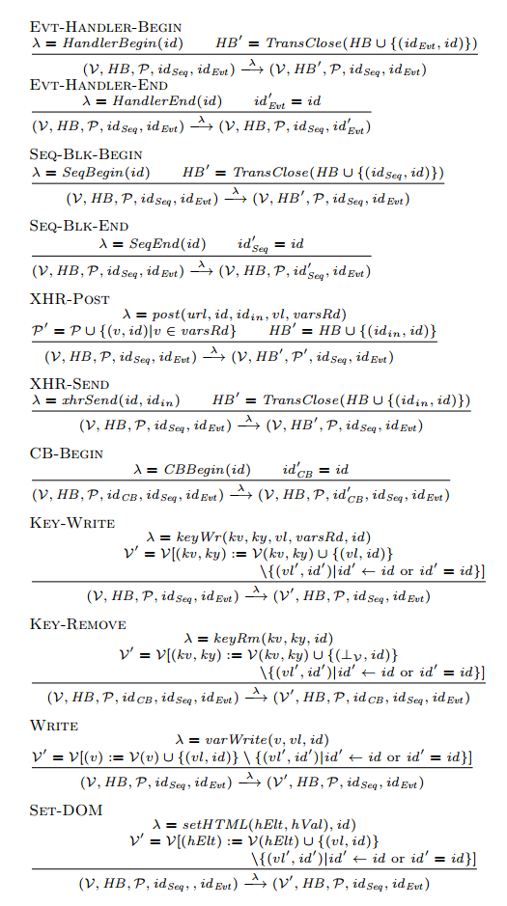
Analysis Rules
Define potential races in terms of flow
  Track data flow to sensitive locations
  Determine when values propagated depends on event order
General outline/intuition:
  Algorithm parses trace line-by-line
  Keep happens-before relation between blocks
  Values written recorded into memory maps
  Merge values written by concurrent blocks
Notes:
We define the potential races by tracking the dflow to sensitive locations
And determine when values propagated depends on event order
The general run down of our analysis is like ….

Slide 19
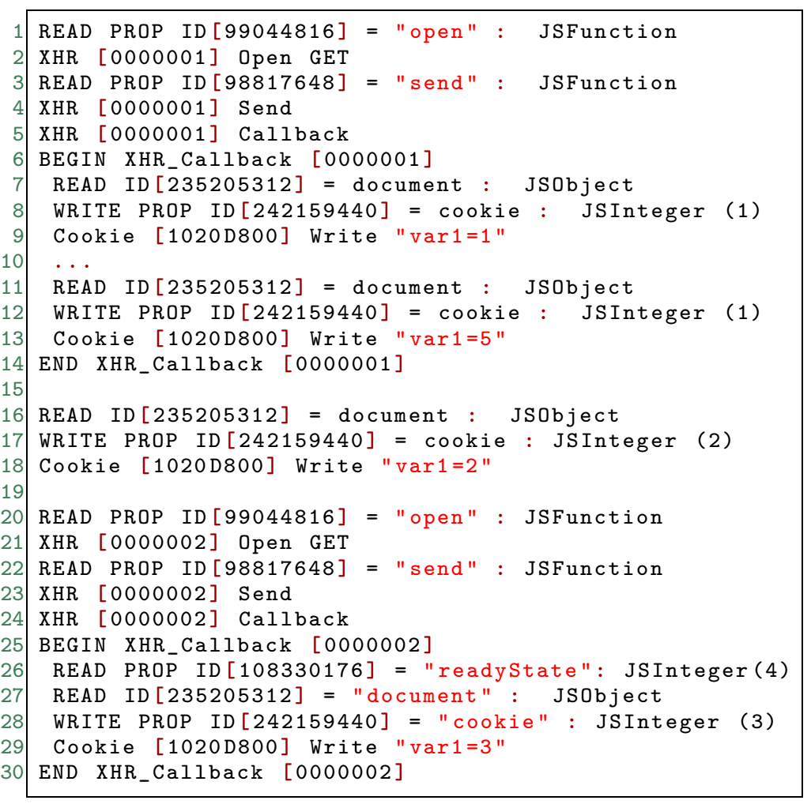
Race Detection Mechanism
Cookie Key | Values
… | …

Slide 20
Race Detection Mechanism
Cookie Key | Values
… | …
var1 | {1,[000001]}
Notes:
Record any written value with their corresponding block id

Slide 21
Race Detection Mechanism
Cookie Key | Values
… | …
var1 | {5,[000001]}
Overwrite values with the happened-before block updates

Slide 22
Race Detection Mechanism
Cookie Key | Values
… | …
var1 | {5,[000001]}

Slide 23
Race Detection Mechanism
Cookie Key | Values
… | …
var1 | {5,[000001]}, {2,[000000]}
Merge values from concurrent block updates
Multiple values in a state points out to a presence of scheduling dependencies
Notes:
the key observation is that instead of separately considering each of the possible schedules, we can encode the effect of the possible race by merging the state and keeping track of multiple, merged values.

Slide 24
Evaluation

Slide 25
Evaluation
Used 26 web sites from Alexa top 4,000 that use XHRs heavily
Collected traces by browsing web sites manually using instrumented Firefox
Analyzed with our race detection mechanism
Notes:
Collected trace by exploring this web pages

Slide 26
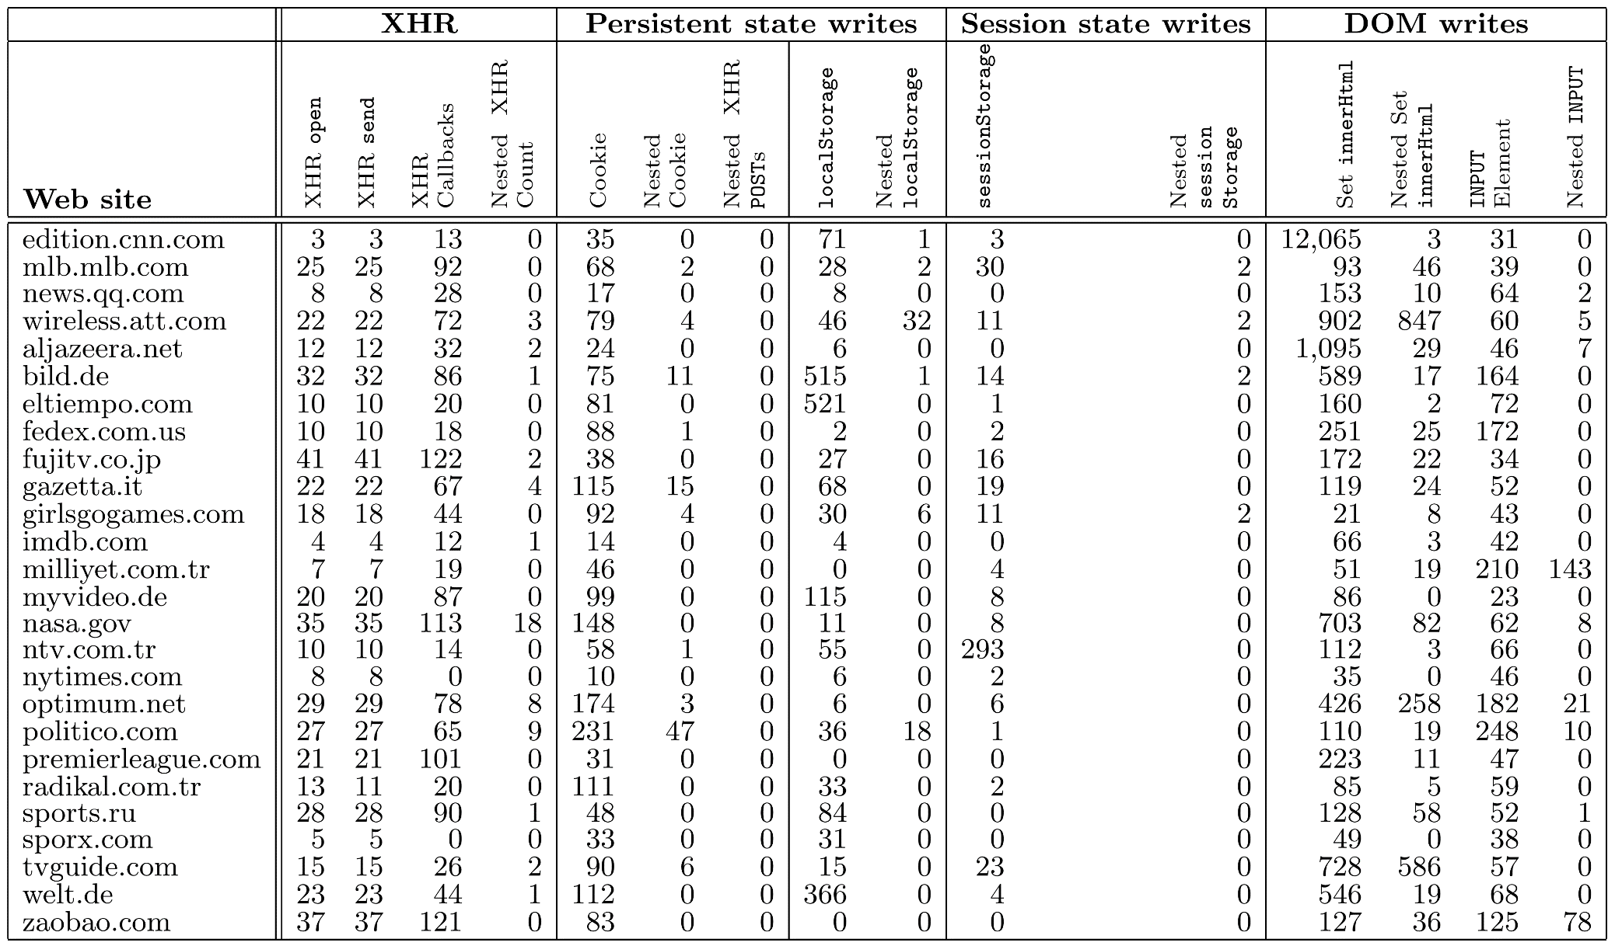
Benchmarks: Web Sites That Use XHR Heavily
Persistent state updates
DOM state updated frequently
XHRs are heavily used

Slide 27
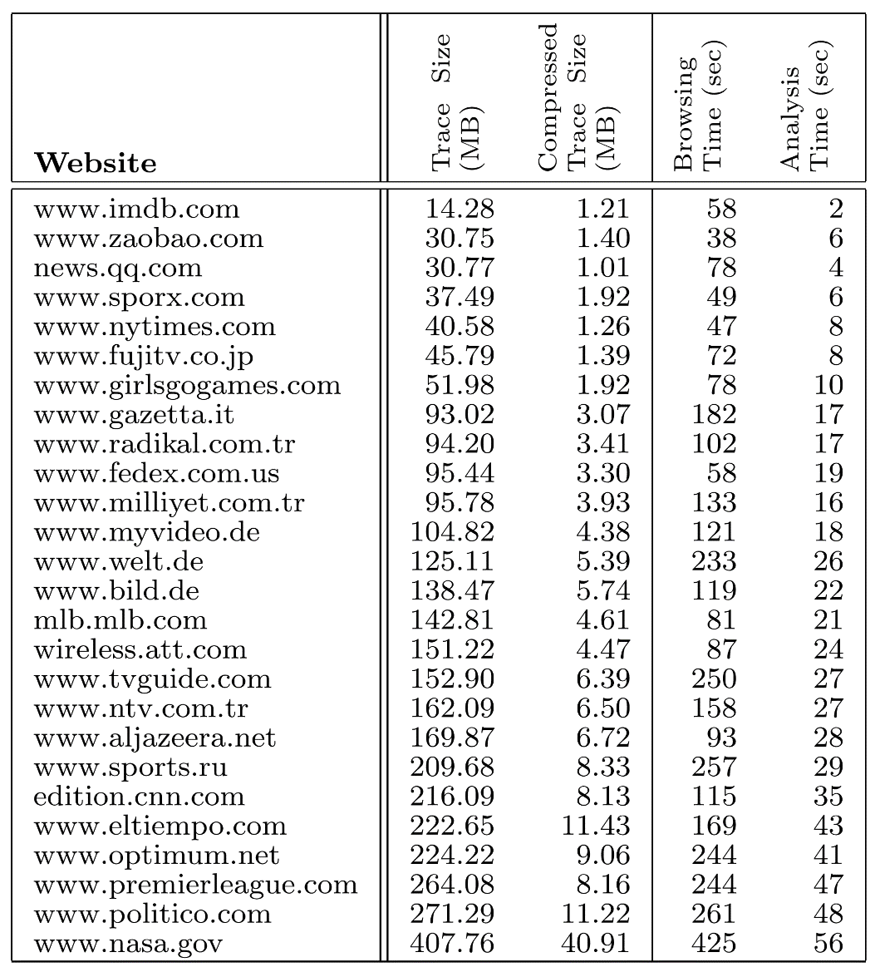
Trace Statistics
Size of the traces are manageably small and well suited for compression
The analysis can be applied online given the analysis time vs browsing time ratio

Slide 28
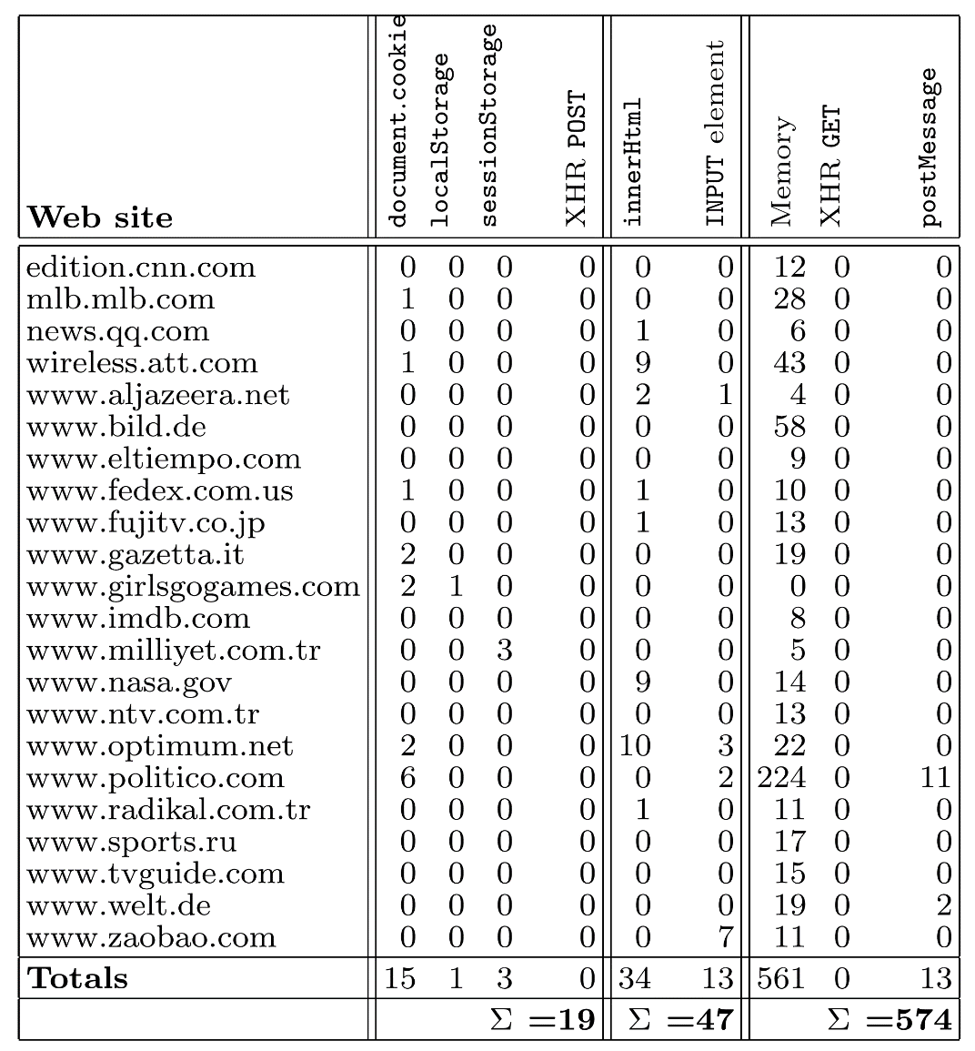
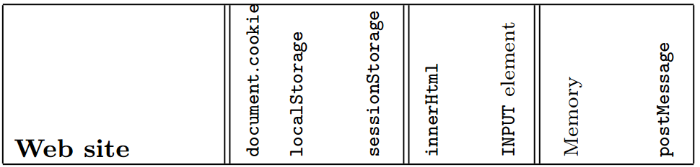
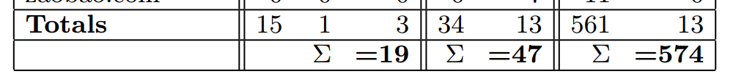
Detected JS Races
Detected only
19 harmful races on persistent + session state
Detected over
600 benign races on transient + DOM state
Notes:
Let’s look at this as graph to emphasize the numbers!

Slide 29
Conclusions
We advocate a differentiation between benign and harmful data races in JavaScript web applications
We propose a lightweight hybrid exploration algorithm for finding data races in runtime traces of JavaScript programs
We find and investigate a total of 19 harmful and 621 benign races in 26 web sites, with only 2 observed false positives

Slide 30
Returning to Research Questions
RQ1: Races on persistent state are quite uncommon, with only 16 for 26 sites
RQ2: Races on session state are also uncommon (only 3 races observed), in part because session state is used not as frequently as cookies
RQ3: Races on transient state are considerably more frequent (527 for 26 sites)

Slide 31
Replication Package
Replication package available with following contents:
  Race detector
  Instrumented Firefox executable
  Collected traces of our benchmark web sites
  Evaluation scripts
msrc.ku.edu.tr/projects/detecting-javascript-races-that-matter

Slide 32
QUESTIONS?

Slide 33
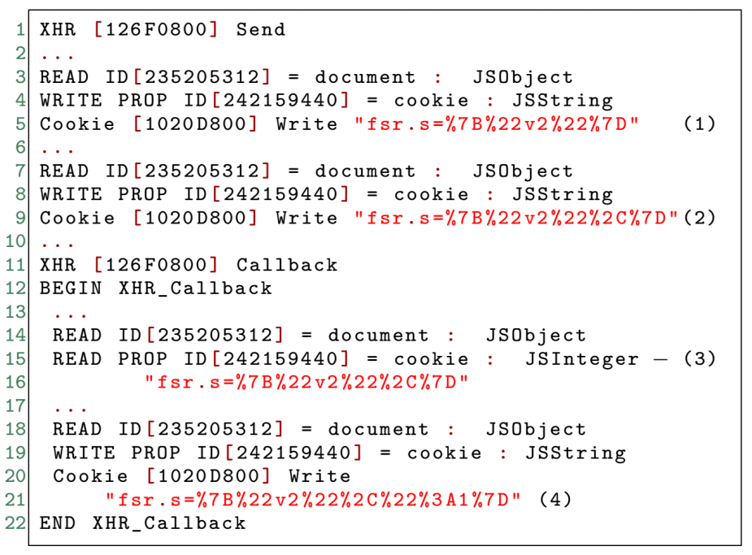
False Positives: optimum.net
Cookie updated with the event happened in the web page

